Slide 1
Deep Dive into Employee Turnover and Salaries
By: Ben Berger

Slide 2
Overview of Data
The data consists of 36 datapoints for employees at Frito Lay.
Each entry represents an employee.
The dataset consists of 870 employees.

Slide 3
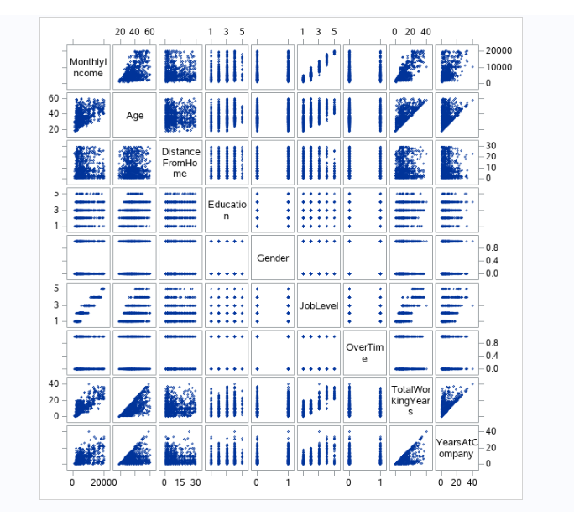
Let’s look at some relationships within the Data
Monthly Income vs Age
Age vs Distance From Home
Monthly Income vs Total Working Years
Monthly Income vs Years at Company
Job Level vs Monthly Income

Slide 4

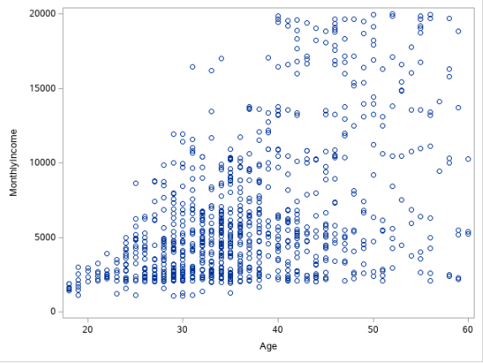
Monthly Income vs Age

Slide 5

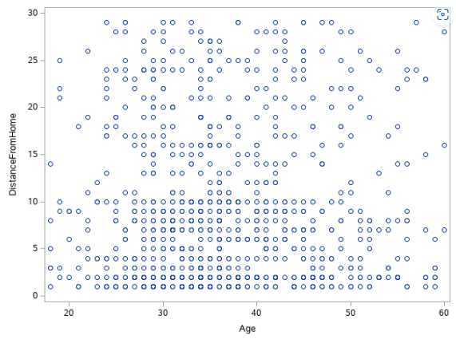
Age vs Distance From Home

Slide 6

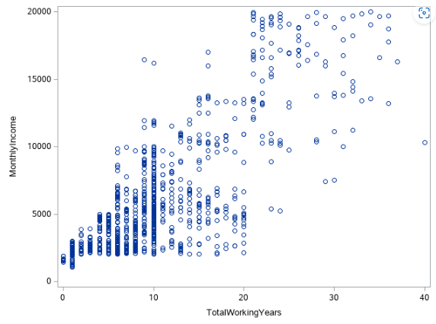
Monthly Income vs Total Working Years

Slide 7
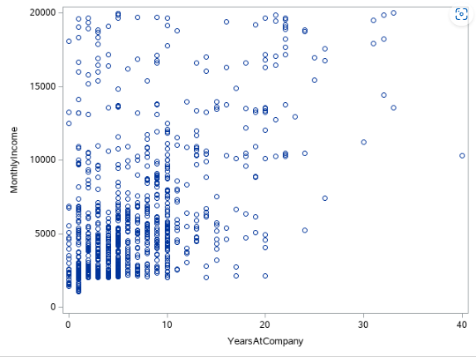
Monthly Income vs Years at Company

Slide 8
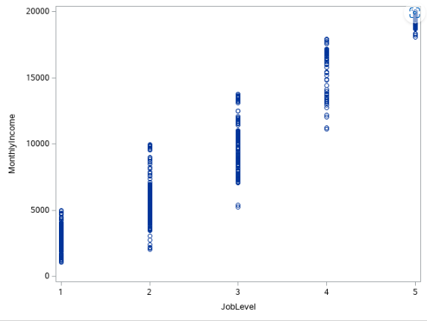
Job Level vs Monthly Income

Slide 9

Objectives
A: Predicting employee turnover.
B: Predicting employee salaries.

Slide 10
Objective A: Predicting employee turnover
From the data, we saw that 730 out of the sample of 870 employees left.
1
Can we use the data available to predict if specific individuals will leave or not?
2

Slide 11
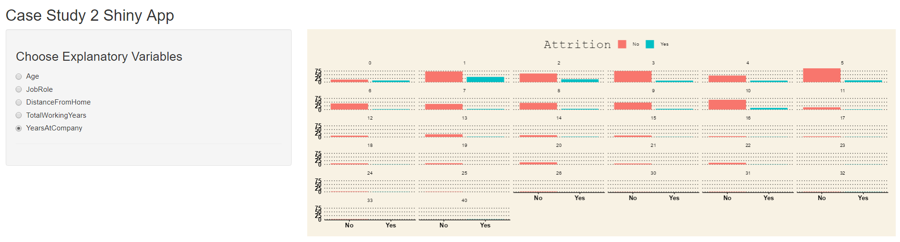
Information on Attrition at Frito Lay
Let's look at some trends of people who left and didn’t leave

Slide 12
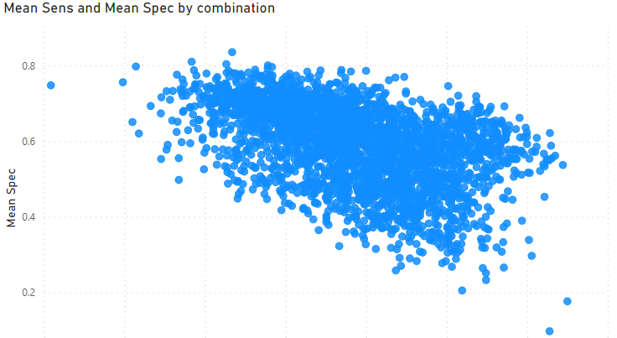
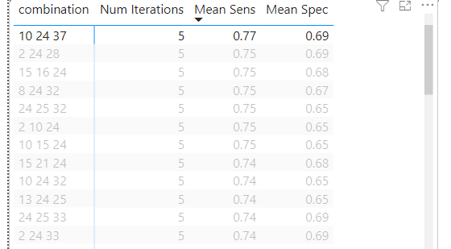
Objective A How to approach what variables we want to use to predict attrition
Instead of choosing randomly, we can use software to find a strong combination of explanatory variables to predict attrition.
For this Objective I used R to run through all combinations of 3 explanatory variables, created a Naïve Bayes model with each combo, and retrieved the Attrition values. Using cross validation against the real values in the data, I could see how well the model performed.

Slide 13



What variables were most useful in predicting if someone will leave or not
Years With Current Manager
Job Involvement
Stock Option Level

Slide 14
How did the model perform?
Averaged an accuracy of 75%.
Averaged a sensitivity of 80%.
Average a specificity of 65%.

Slide 15

Objective B: Predicting employee salaries

Slide 16
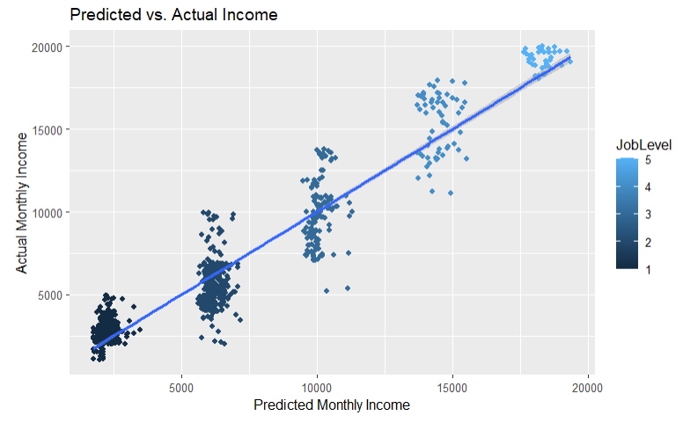
Objective B How to approach what variables we want to use to predict an employee's salary.
Instead of choosing randomly, we can use software again to find a strong combination of explanatory variables to predict what an employee's salary is.
For this Objective I used SAS to run through all combinations of explanatory variables, created a linear regression model with the combination with a strong correlation with Salary, and estimated their values.
After getting a strong combination, I used R to create a linear regression model with the explanatory variables chosen.

Slide 17
Conclusion
With the use of software, we can get a little insight into predicting.
Things to consider, the models used for prediction only good for the sample used. May not be representative of another sample necessarily.

